Slide 1





Supply Chain Domain Project.
tliQ
Mart
AtliQ Mart is a growing FMCG company based in Gujarat, India, currently operating in Surat, Ahmedabad, and Vadodara. The company plans to expand its operations to metro and Tier-1 cities within the next two years. Before expansion, AtliQ Mart aims to strengthen its supply chain performance and improve customer service by using data-driven decision-making.

Slide 2




tliQ Mart
Problem Statement
AtliQ Mart is facing delivery-related service issues where some important customer orders are not delivered on time or in full. Due to these repeated problems, a few key customers have decided not to renew their yearly contracts. This is affecting customer trust and business growth. To solve this, the company needs to closely monitor delivery performance on a daily basis.

Slide 3

tliQ Mart
OBJECTIVES
OBJECTIVE 01
To check how well orders are delivered on time and in full across customers, cities, and months.
OBJECTIVE 04
To understand trends over time and see whether service levels are improving or not.
OBJECTIVE 02
To identify customers and cities with poor delivery performance that need immediate attention..
OBJECTIVE 05
To support business decisions by highlighting problem areas using data-driven insights.
OBJECTIVE 03
To compare actual delivery performance with target levels and find performance gaps.

Slide 4
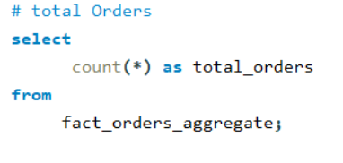
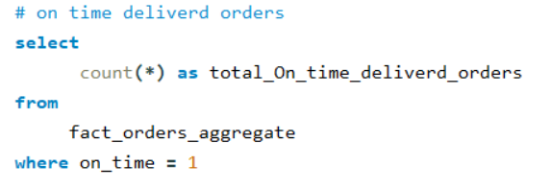
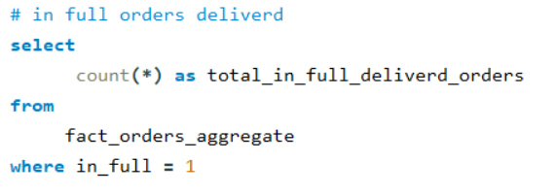
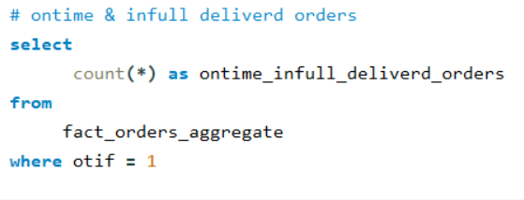
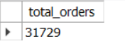
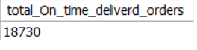
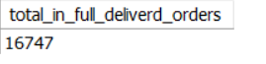
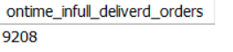
Ad Hoc Analysis: Key Insights & Findings
Important KPIs
Total Orders
On Time Delivered Orders
In Full Delivered Orders
Ontime & InFull Delivered Orders

Slide 5
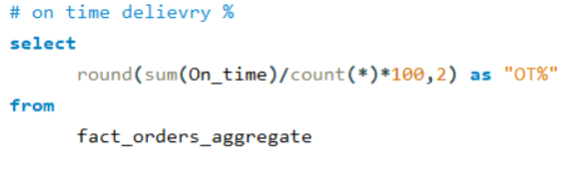
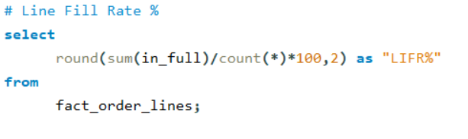
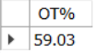
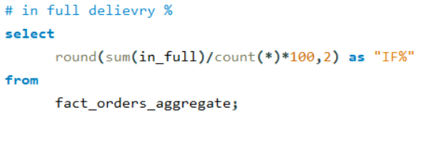
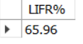
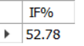
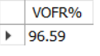
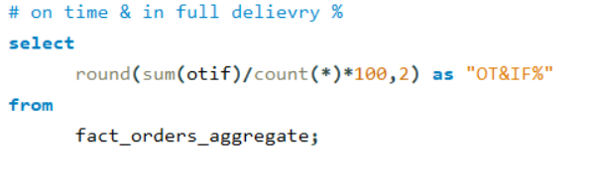
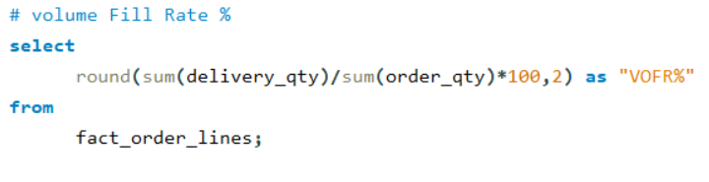
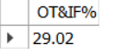
Important KPIs
Line Fill Rate %
On Time Delivery %
In full Delivery %
On Time & In full Delivery %
Volumn Fill Rate%

Slide 6

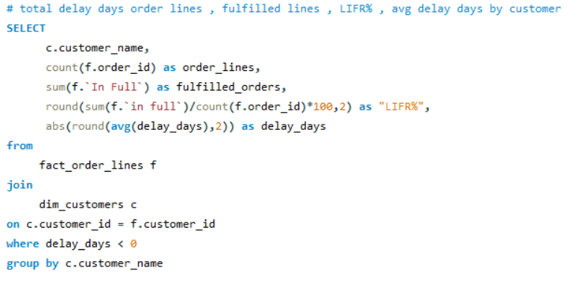
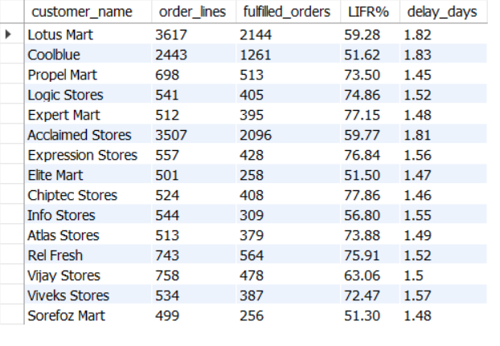
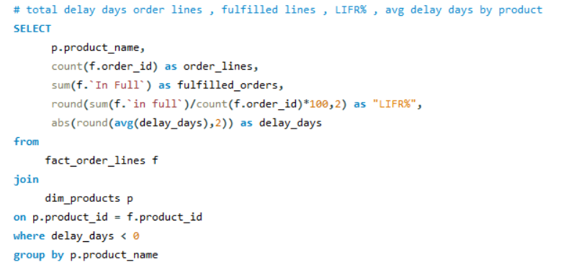
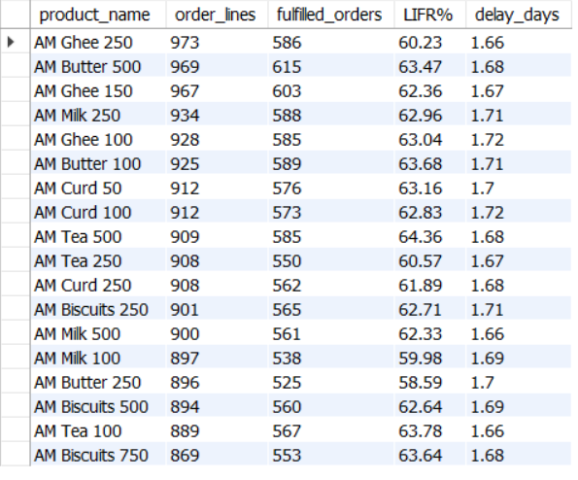
Order Lines , Line Fulfilled, LIFR% , Delay Days by Customer & Product
customers with high order volumes show lower fulfillment rates while average delivery delays remain around 1.5–1.8 days, indicating a need to improve fulfillment efficiency for key customers.
Across products, LIFR remains moderate (around 60–64%) with consistent delivery delays of ~1.6–1.7 days, indicating a systemic fulfillment and logistics efficiency issue rather than a product-specific problem.

Slide 7
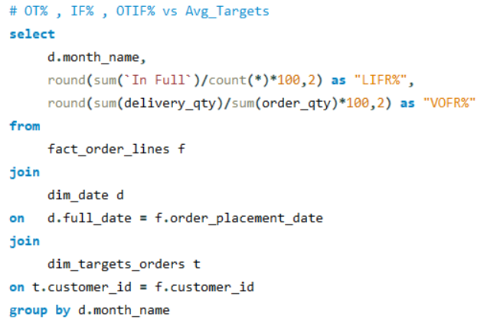
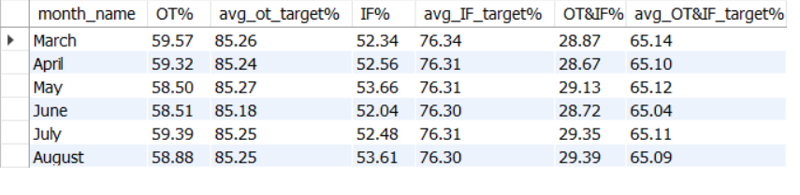
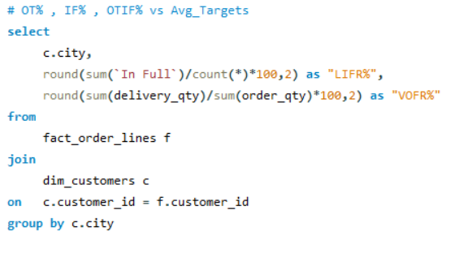
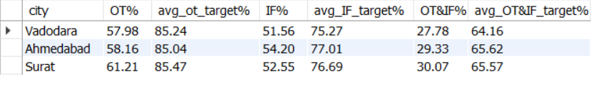
OT% , IF% , OT&IF% vs Targets by City & Month
Across all months, OT%, IF%, and OT&IF% are consistently much lower than their target values, showing a continuous service gap.
Performance remains almost flat from March to August, which means there is no major improvement or decline over time.
Among cities, Surat performs slightly better, while Vadodara shows the lowest OT% and OT&IF%, making it the biggest area for improvement.

Slide 8
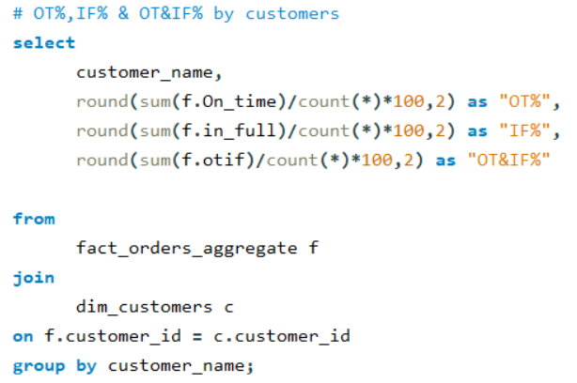
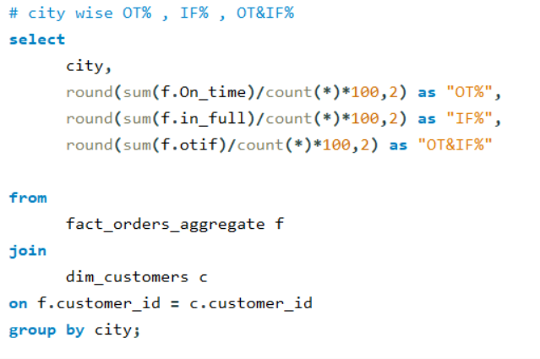
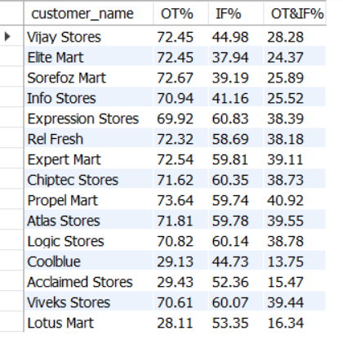
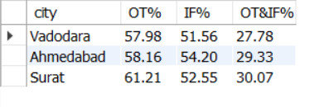
OT% , IF% , OT&IF% by Customer & Product
Most customers have OT% around 70–73%, but their OT&IF% is much lower, showing delays and incomplete deliveries together.
Customers like Coolblue, Acclaimed Stores, and Lotus Mart have very low OT% and OT&IF%, making them high-risk customers.
Among cities, Surat performs better, while Vadodara has the lowest OT% and OT&IF%, indicating bigger delivery challenges there.

Slide 9
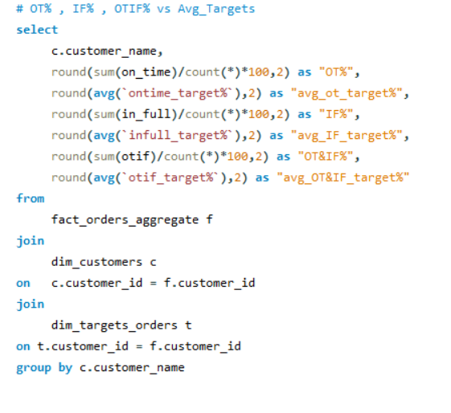
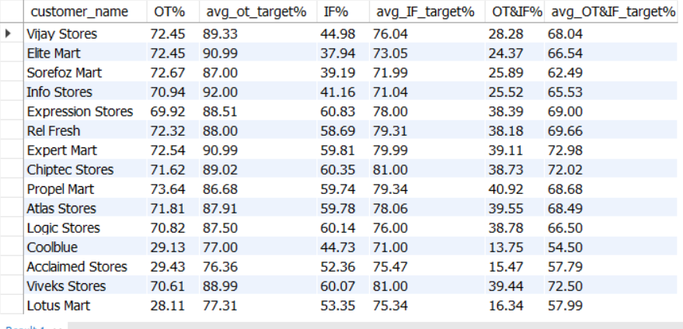
Input
OT% , IF% , OT&IF% vs Avg Targets by Customer
Output
Most customers have OT% around 70–73%, which is below the average OT target of nearly 88–91%, showing delays in on-time delivery.
In-Full (IF%) performance is stronger than OT% for many customers, but still does not meet the target levels.
Customers like Coolblue, Acclaimed Stores, and Lotus Mart show very low OT% and OT&IF%, making them key areas of concern.

Slide 10
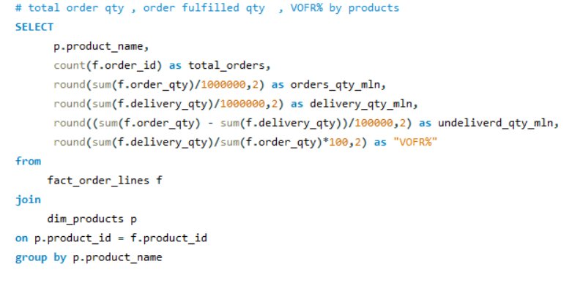
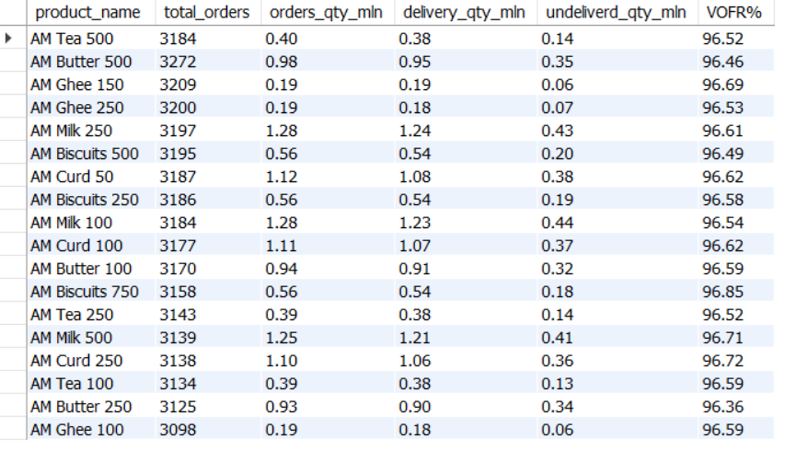
Input
Total Orders ,Orders Qty ,Delivery Qty, undelivered Qty VOFR% By Product
Output
All products show a strong fulfillment rate of around 96–97%, indicating reliable delivery performance.
Milk and Curd products lead in both order and delivery volumes, making them the highest-demand items.
Undelivered quantities are minimal across products, suggesting only small gaps in supply that can be improved with better inventory planning.

Slide 11
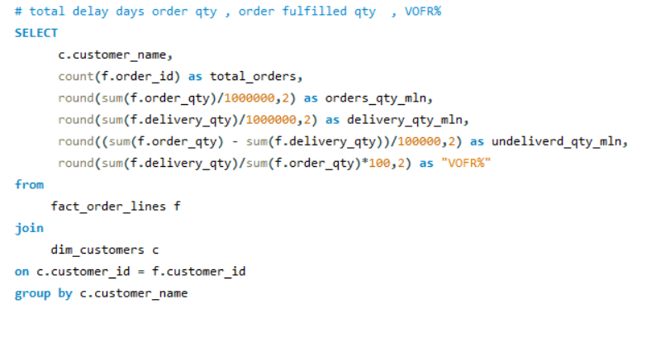
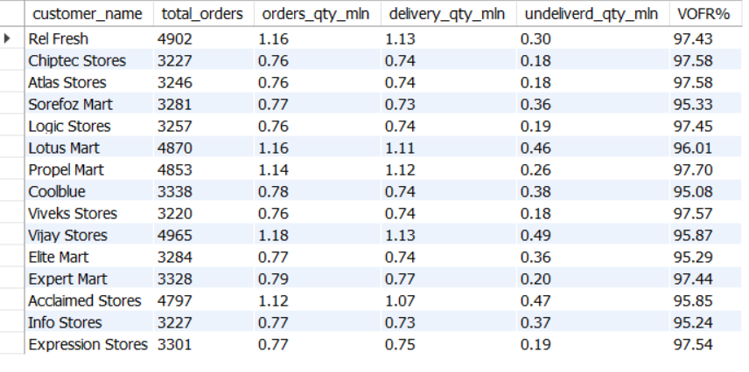
Total Orders ,Orders Qty ,Delivery Qty, undelivered Qty VOFR% By Customer
Most customers have a high VOFR% between 95% and 98%, which shows overall good order fulfillment performance.
Customers like Vijay Stores, Lotus Mart, and Acclaimed Stores have higher undelivered quantities, indicating delivery gaps.
Even though order and delivery quantities per minute are similar, small delivery delays are causing noticeable fulfillment losses for some customers.

Slide 12
Thank You

